Slide 1

ENHANCING SEARCH ENGINE USER EXPERIENCE THROUGH PERSONALIZATION

Slide 2





Abstract
CHALLENGE: Existing search engines raise privacy concerns while lacking optimal user experience, particularly in accessing personal data sources.
SOLUTION: Develop a search engine focused on user privacy and improved data retrieval:
PRIORITIZE USER PRIVACY: Protect search data from unauthorized access and ensure user control over its use.
ENHANCED USER EXPERIENCE: Provide efficient and relevant information retrieval from both web searches and personal knowledge bases.
Impact: Improve search comfort and data access while addressing privacy concerns.

Slide 3




Problem Statement
Query Understanding & Reformulation: AI-powered algorithms will understand user intent and suggest relevant search reformulations for accurate results.
Enhanced Semantic Search: Machine learning models will improve the ability to find information based on the meaning and context of the query, not just keywords.
Personalized Search & Recommendations: Leveraging past searches, the system will recommend relevant information from knowledge bases based on user preferences and behavior.

Slide 4
Functional Requirements
1. The Model should accurately analyze user search history, demographics, and browsing patterns.
2. It should provide personalized suggestions and improve query prompts based on user context.
3. It should deliver more relevant and accurate search results.
4. User authentication and search history tracking.
5. Vector Database for storing and retrieving user data.

Slide 5
Non-Functional Requirements
The Model should be scalable to handle large volumes of user data and search queries.
It should be responsive and provide real-time suggestions.
Maintain user privacy and data security.
Secure storage and transmission of user data.
Users of any level of expertise should find this model to be simple to use.
Users should always be able to access the model and it should be reliable.
This model should be accessible to users with disabilities.

Slide 6
Hardware Requirements
CPU: A multi-core processor with decent clock speed is recommended for efficient code execution and handling of background tasks.
RAM: At least 16GB of RAM is recommended to ensure smooth operation, especially while working with large datasets or complex models.
Storage: Sufficient storage space (SSD preferred for faster data access) is needed to accommodate the project's code, datasets, and any pre-trained models.
Graphics Processing Unit (GPU): This is the crucial component for the project, as it allows for efficient training and running of LLMs.
GPU Memory: The required GPU memory (VRAM) depends heavily on the specific LLM models used in the project.

Slide 7
Software Requirements
Python: Version 3.6 or later is required to ensure compatibility with the utilized libraries and frameworks.
PyTorch: Version 1.7 or later is recommended for deep learning functionalities, especially if neural network models are used for personalization or knowledge retrieval tasks.
ChromaDB: Version 0.5 or later serves as the vector database for storing and retrieving vector representations of text data.
Langchain: Version 0.9 or later (optional) provides functionalities for working with large language models, potentially used for knowledge retrieval or other relevant tasks.

Slide 8



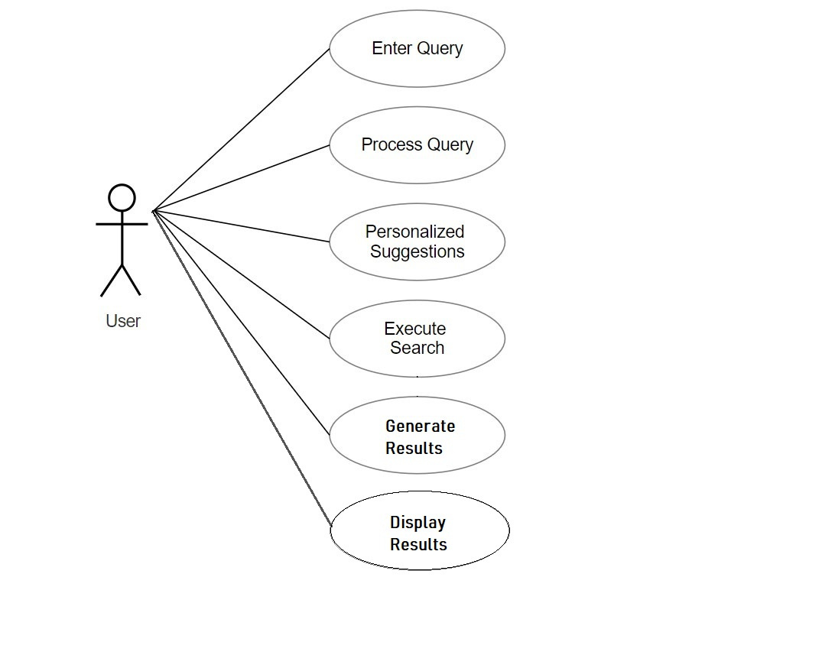





Use Case Diagram

Slide 9
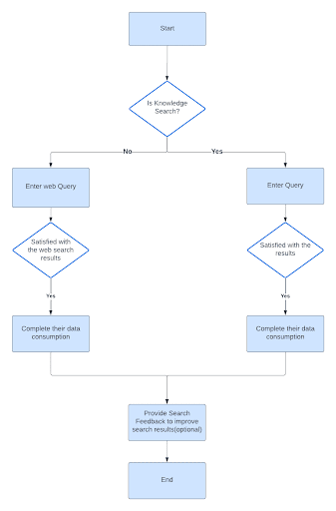

Activity Diagram

Slide 10
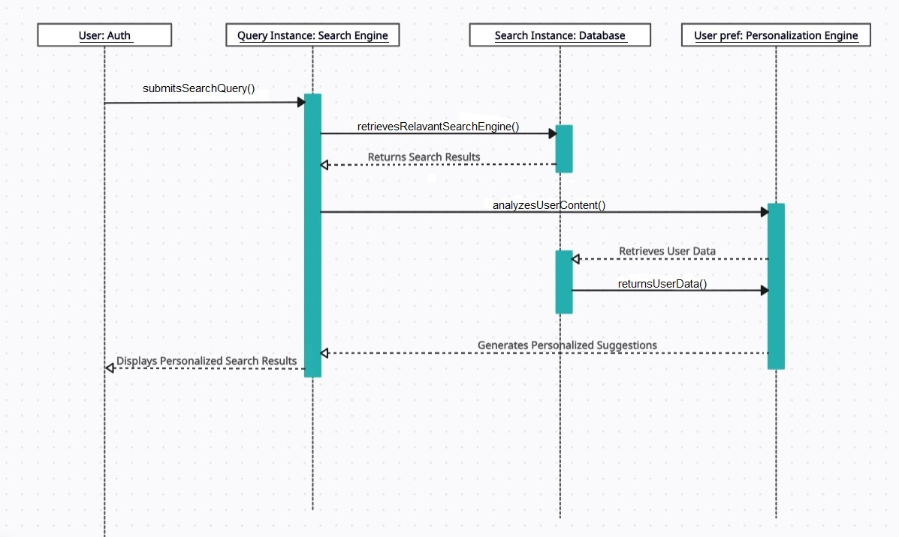
Sequence Diagram

Slide 11
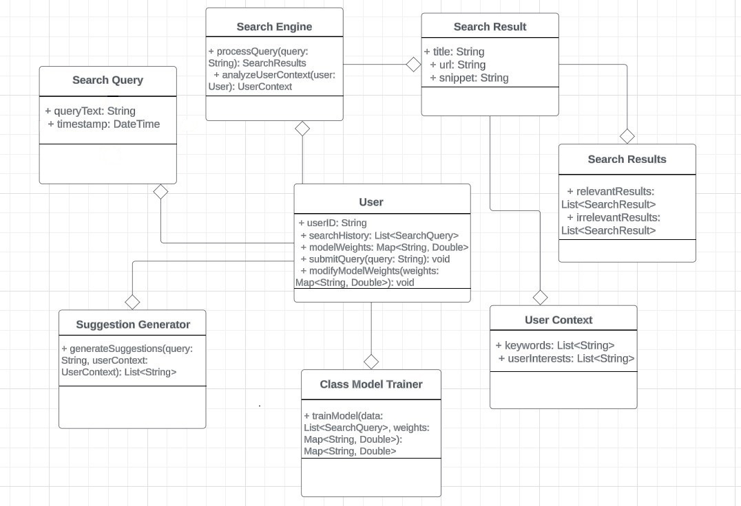
Class Diagram

Slide 12


Software Environment
Operating System: Likely Linux due to its open-source nature and support for Python development.
Development Tools: Python code editors or IDEs for writing, editing, and debugging code.
Libraries & Frameworks: PyTorch, Langchain, and others installed using package managers like pip.
Hardware: System with a GPU for efficient LLM processing and memory sufficient for the chosen LLM models.

Slide 13
Transformers Neural Network
The Transformer neural network architecture, revolutionized natural language processing and other sequential data tasks. Unlike traditional recurrent neural networks (RNNs) or long short-term memory networks (LSTMs). The architecture consists of an encoder-decoder framework, each comprising multiple layers. The self-attention mechanism allows the model to weigh the importance of different words dynamically, enabling effective processing of long-range dependencies. Positional encoding is incorporated to provide information about the order of words. Transformers have demonstrated remarkable success in various applications, including machine translation, text generation, and language understanding, and have become a foundational architecture in modern deep learning.

Slide 14

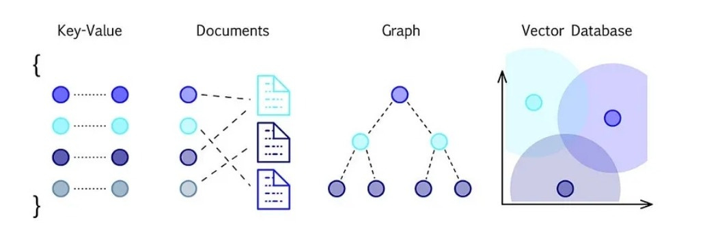

Vector Database Architecture
The project utilizes a vector database (ChromaDB) to store user search preferences and queries as numerical representations (vectors). This allows for efficient similarity searches, enabling personalized search results and identifying related information in the knowledge base.

Slide 15
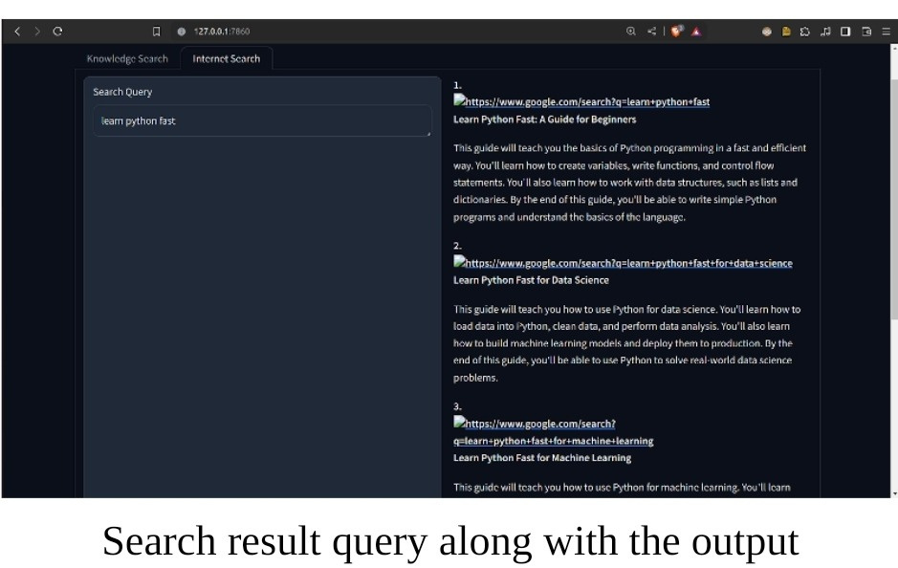
Output Screens

Slide 16

Test Cases
1
Test Case Name: User Entering Search Query
Scenario:This test case verifies the system's ability to handle user input and process search queries.
Expected Results: The query is accepted and processed without errors. No error messages are displayed to the user. The system extracts keywords successfully.
2
Test Case Name: Personalized Search Query
Scenario: This test case verifies the functionality of generating personalized search queries based on user context and search history.
Expected Results: Personalized suggestions are displayed based on the user's search history and model weights

Slide 17

Conclusion
In conclusion, this project has explored the unique potential of vector database tools to enhance search engine user experience through a two-pronged approach. By leveraging the inherent strengths of this technology, the project has successfully demonstrated its ability to not only personalize search queries based on individual user preferences and behavior but also act as a powerful knowledge retrieval system. This dual functionality offers a compelling path forward for search engines, promising a future where users can encounter a more intuitive, efficient, and ultimately satisfying search experience.

Slide 18






